Slide 1
A Tactical Approach to Mitigating Aircraft Noise Through Collaboration and Use of New Noise Metrics
Presenter- Mel Beale, Airport Working Group of Orange County
March 6, 2024
Panel- Representing Aircraft Noise Impacts – A Community Perspective

Slide 2
Objective
To present a path toward the acceptance of technically viable alternative noise metrics more fair to the entire stakeholder community through tactical and comprehensive analysis models-
  By leveraging our work done for a typical single commercial airport and
  Enlisting broad support from the government and community eco-system to
  Support adoption of alternative metric models

Slide 3
John Wayne Airport Departure Track
Noise Monitor 6
Noise Monitors locations
(depicted as red pin symbol)
KSNA Runway 20R south departure
PIGGN Track

Slide 4
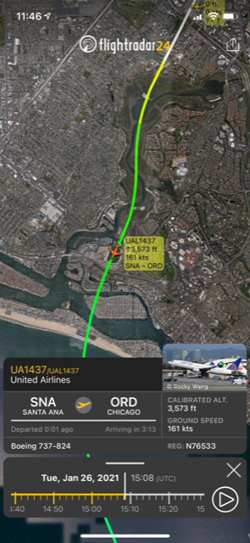
Commercial Airline
B737-800 Departure from John Wayne Airport
Jan. 26, 2021
Procedure flown
-STAYY3
-NADP-1,
-1200’ Throttle cutback from Take Off engine power to Climb

Slide 5
Background on Data Source
AWG Noise Mitigation Study Analysis
2021-2023
AWG study objective was to determine alternative departure procedures at JWA… takeoff procedure options, multiple flight tracks, engine power cutbacks at different climb altitudes … which would result in lower community noise
Some actual commercial flight departures were used but deep analysis required a high volume of FOQA like flight management system data
Solution- Use B737-800 flight simulators (SIMs) to fly procedures
  16 hours of SIM time was reserved and over 30 different departures were “flown”

Slide 6
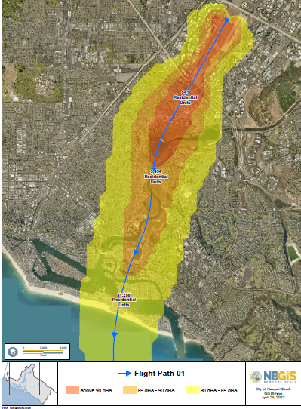
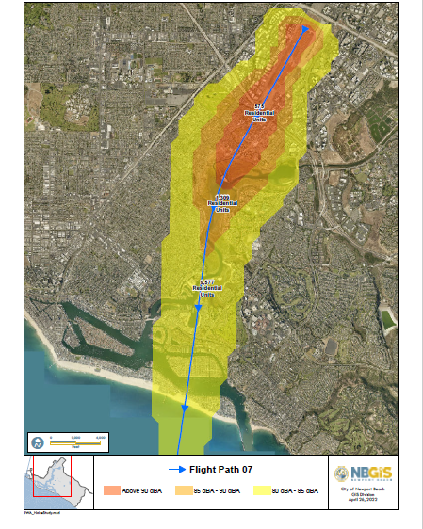
SIM flight alternative 737-800 procedure
AWG Study – Preliminary Results
Visual comparison of estimated
current departure procedure to
an alternative procedure at JWA.
SIM flight 1- approximates current commercial departure
Single noise equivalent level noise contours
SIM flight with different departure procedures from
standard . Single event equivalent level noise contours
Current procedure approximation from 737-800 SIM run
Estimated noise mitigation benefit to impacted populations of an alternative procedure shown in SEL noise contours.
Note the reduced width and length of each noise contour color
As shown by the arrows and lines in each graphic as examples of
reduced high noise exposure zones.

Slide 7
AWG Noise Mitigation Study Analysis
2021-2023
Objective was to determine alternative departure procedures… takeoff procedure options, multiple flight tracks, engine power cutbacks at different climb altitudes … which would result in lower community noise
Some actual commercial flight departures were used but deep analysis required a high volume of FOQA like flight management system data
Solution- Use B737-800 flight simulators (SIMs)
  16 hours of SIM time was reserved and over 30 different departures were “flown”
Derivative value- SIM data models generated noise contour maps which can be used for other analytical purposes->
        Graphical Visual Analytical Models for FAA Noise Control Metrics to Replace / Supplement the 65DNL

Slide 8
Proposed Illustrative Noise Metric Model example
Premise(s) of current deficiency of 65DNL and proposed alterative
  65DNL time span (24 hours / 365 days) is not a valid time span model to use to measure community impact from aircraft noise
  A proposed set of continuous smaller time window segments would be more appropriate measures of noise intensity impact
    For example- the 1st 4 hour period of heavy departure traffic at any high volume commercial airport, USA, and each 4 hour segment thereafter over the 24 hour day.
    Each 4 hour segment could have a new control noise limit metric with math models generated similar to the 65DNL algorithm
    New airport baselines could be set in 20XX. Any new projects (Part 150 requirements) or programs (i.e., like NEXGEN) would be controlled by whether it negatively influenced the derived 4 hour metrics at that airport.

Slide 9
AWG submitted a response to the FAA’s request to the public on revisions to the “noise policy and noise metrics” used
in all federal programs and projects. This is a critical opportunity for real impact improvements. The AWG response was
eighteen (18) pages and quite detailed. Below is an excerpt of graphics used to illustrate an AWG recommendation.
Illustration of Example of ISL Leq Metric Model Time Segments*
* Source of original top graphic- Report to Congress FAA Reauthorization Act of 2018 :Section 188, page 9

Slide 10
AWG submitted a response to the FAA’s request to the public on revisions to the “noise policy and noise metrics” used
in all federal programs and projects. This is a critical opportunity for real impact improvements. The AWG response was
eighteen (18) pages and quite detailed. Below is an excerpt of graphics used to illustrate an AWG recommendation.
Illustration of Example of ISL Leq Metric Model Time Segments
Proposed 4 hour L_{eq}
Segmentation for
new noise control
metric vs 65DNL,
24 hour / 365
shown above
Time Slice Segments L_{eq} 1 L_{eq} 2 L_{eq} 3 L_{eq} 4

Slide 11
Proposal- FAA define a new noise control metric
Use cumulative 4- hr. L_{eq} ‘s to create metric baselines from historic departure and arrival data for airports
For analytical purposes, AWG used captured flight simulator data to simulate actual departure and arrival operations to create an estimated 4 hr. baseline measure (for typical airport operations busiest periods)
How would the 65DNL noise contour compare to the proposed 4- hr. L_{eq} ‘s ?

Slide 12
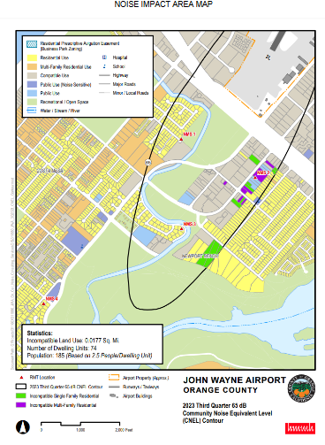
Example-
Current
John Wayne Airport
65 CNEL Contour
Q3- 2023

Slide 13
Illustration of
Current Commercial Airline
B738 SNA Departure
Procedure & Track Noise
Contours for SEL using FAA
AEDT- 3e tool
(generated using Simulator
Flight Management System
data based on
AWG parameters to
10,000 Ft AFE)
65 CNEL Contour approximation Q3 2023
Single Departure Event Noise Level
Contour Boundaries from Simulator Data
Above 90dB per AEDT -3e model
(Amber color ) boundary
Above 85 dB per AEDT -3e model
(Golden color ) boundary
Above 80 dB per AEDT -3e model
(Yellow color ) boundary

Slide 14
Model Analysis
“Exam” Question- What would a 4 hour metric look like using 65DNL like formulas to draw a 4 hour contour map?
  Nomenclature- 4HQ (Based on 4 hour Cumulative L_{EQ} using DNL like math algorithm)
  Use 4 hour time quadrants across 365 day year
  Use for Part 150’s and local noise ordinances where allowed

Slide 15
65 CNEL Contour approximation Q3 2023
Illustration of estimated
“New” 4HQ Metric
boundary?
Above 90dB SENL per AEDT -3e model
(Amber color )

Slide 16
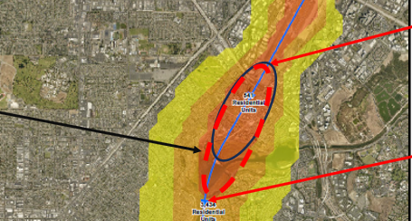
Drill down for a departure comparison of current and proposed new metrics
“Illustrative Only”
for discussion purposes
Current SNA 65 CNEL
Contour Approximation
(Q3 2023)
“Proposed 4 hr. contour map
boundary estimate”
Impacted surrounding areas
would likely be 50%⁺ in sq. miles
versus the 65CNEL.
Departure Track
& 90dB SEL contour
boundary

Slide 17
Model Analysis
“Exam” Question- What would a proposed 4 hour metric look like using 65DNL like logarithmic formulas to draw a 4 hour noise contour?
  Nomenclature- 4HQ (Based on 4 hour Cumulative L_{EQ} using DNL like math algorithm)
  Use the proposed 4 hour time quadrants across 365 day year @ two (not a single one) noise metric contour map levels- 65dB and 55 dB
  Use resulting metrics for control of allowable changes due to Part 150’s, new FAA procedures, and local noise ordinances where allowed
  Second metric – L_{max-} based on the same 4 hour models so that the two metrics are both controlling limits for all new changes – capital or procedural in airport near airspace.

Slide 18
Closing Messages
65DNL is widely unpopular and has yielded little protection to communities at large
FAA has opened the door to innovative approaches to provide balance to future Part 150 expansions or flight procedure changes like NEXGEN
AWG recommends a “blue ribbon” empowered committee be established with a tight report-out time window to review suggestions, recommendations and models to replace the current 65DNL with a “set” of metrics (not a single metric) for measuring and controlling aircraft movement operations on the communities impacted. One proposed option- 4 Hr segmentation metric.

